Slide 1


Reaction Insights for Social Buzz

Slide 2


Today's agenda
Project recap
Problem
The Analytics team
Process
Insights
Summary

Slide 3

Social Buzz is a fast growing technology company that need to adapt quickly to a global scale. Accenture has begun a 3 month POC focusing on the following tasks:
Audit of their big data practice
Recommendations of a successful IPO
Analysis of top 5 popular categories of content
Project Recap

Slide 4

Problem
Over 100 000 posts per day.
36 500 000 pieces of content per year.
But how can they capitalize on so much data?
Analysis to find out their top 5 most popular categories of content.

Slide 5



Alexa Gunning
Data analyst
The Analytics team
Andrew Fleming
Chief Technology Architect
Marcus Rompton
Senior principle

Slide 6
Process
1
Understand the data
2
Clean the data
3
Model the data
4
Analyse the data
5
Uncover insights

Slide 7

Insights
16 Unique Categories
Most Popular Category: Animals with 1897 Reactions
January has the Most Posts

Slide 8
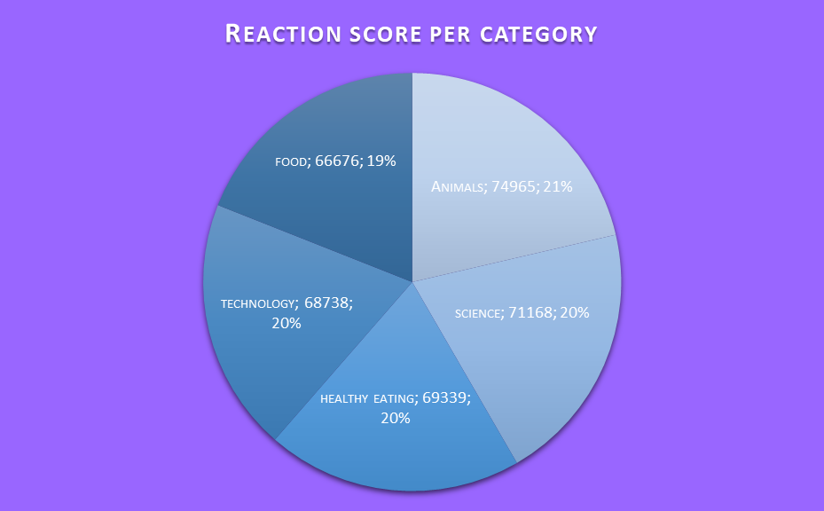

Slide 10

Animals, science and healthy eating are the three most popular categories. People enjoy facts and authentic content.
Food is the fifth post popular category and healthy eating is the third so people are interested in food and focusing on this could attract more customer engagement.
Teaching you how to work with you data for more insight is the next step.
Summary

Slide 11
Thank you!
ANY QUESTIONS?

